Slide 1
Transports through EAST2 boundary

Slide 2
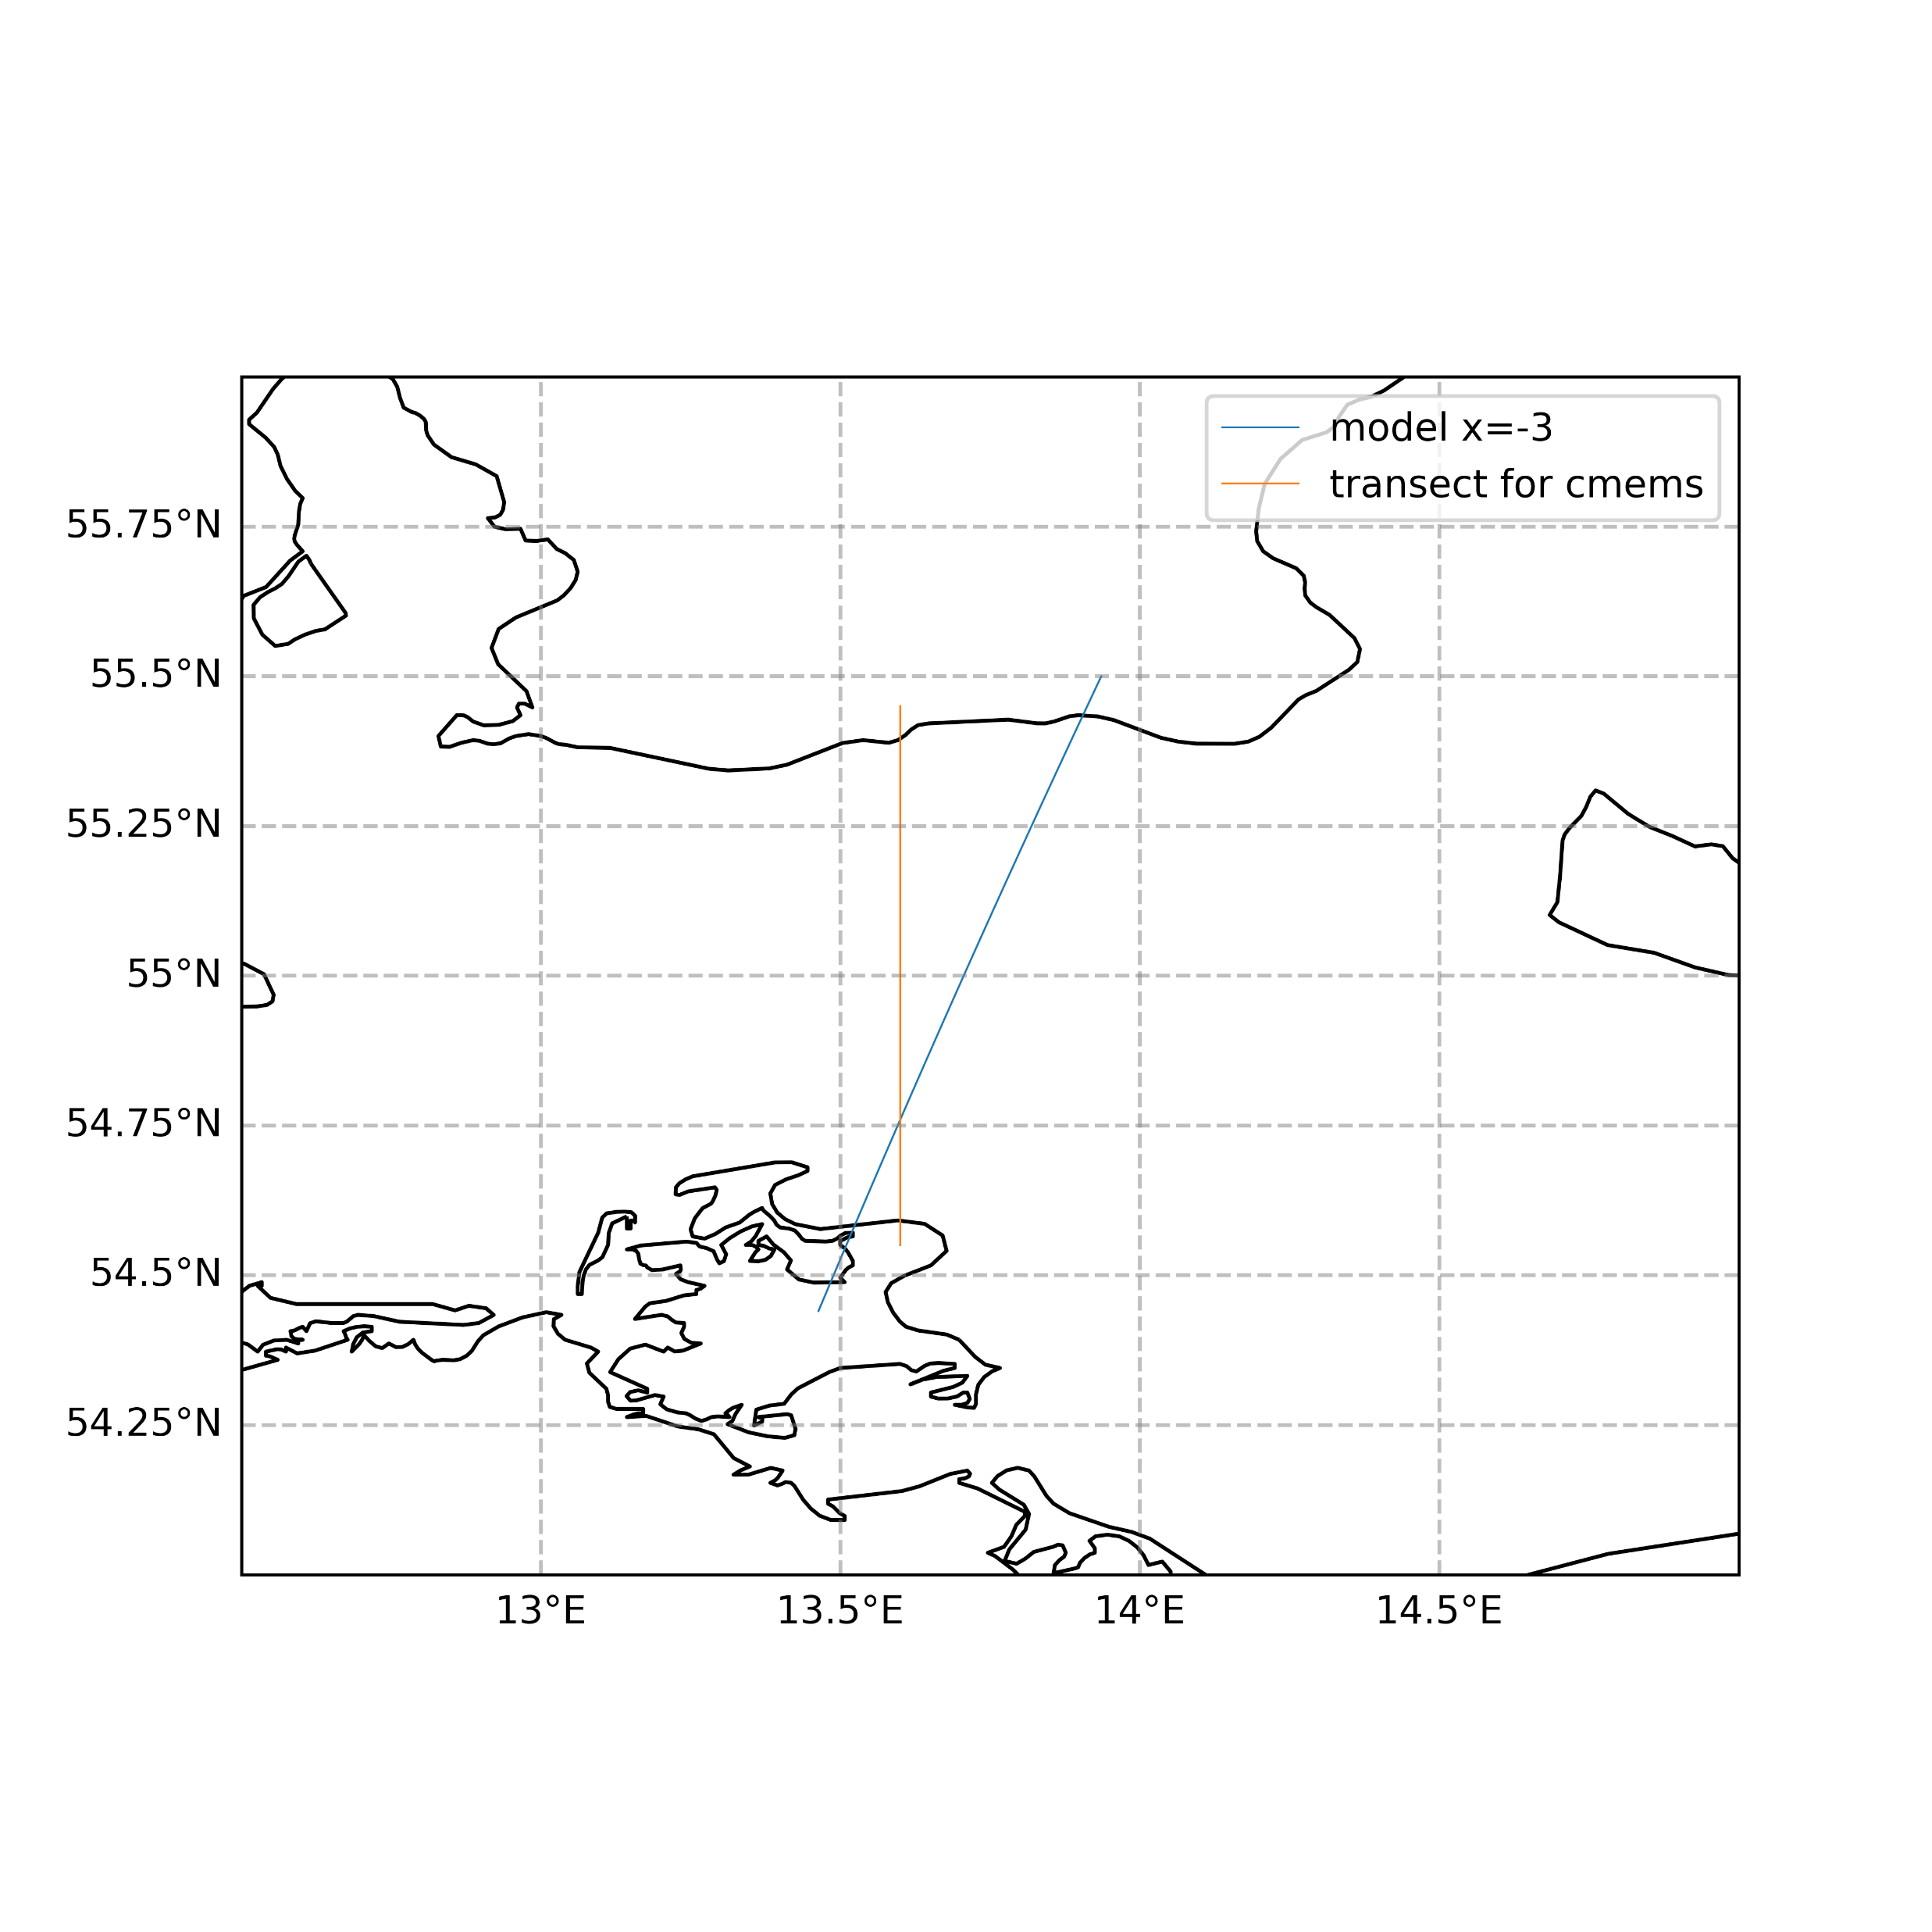
Blue transect is the line where the transports of volume,heat,salt are computed from model native mesh (also for OBC files). The calulation is done 2 lines inside domain.
Orange line is the same for CMEMS

Slide 3
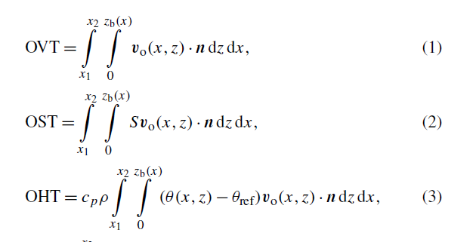
Calculations of transports are done according to (Winkelbauer,2024)
Here I multiply by ρ to have tons
Cp = 3996 J/kg/K
Tref = 0

Slide 4
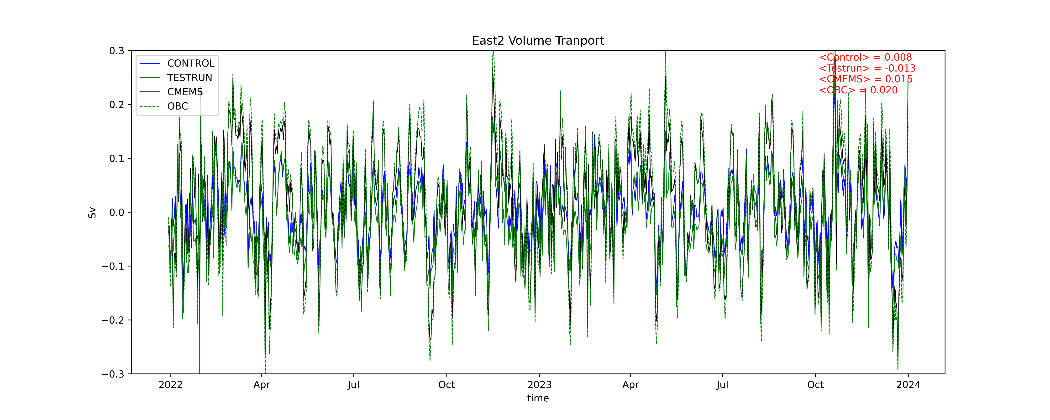

Slide 5
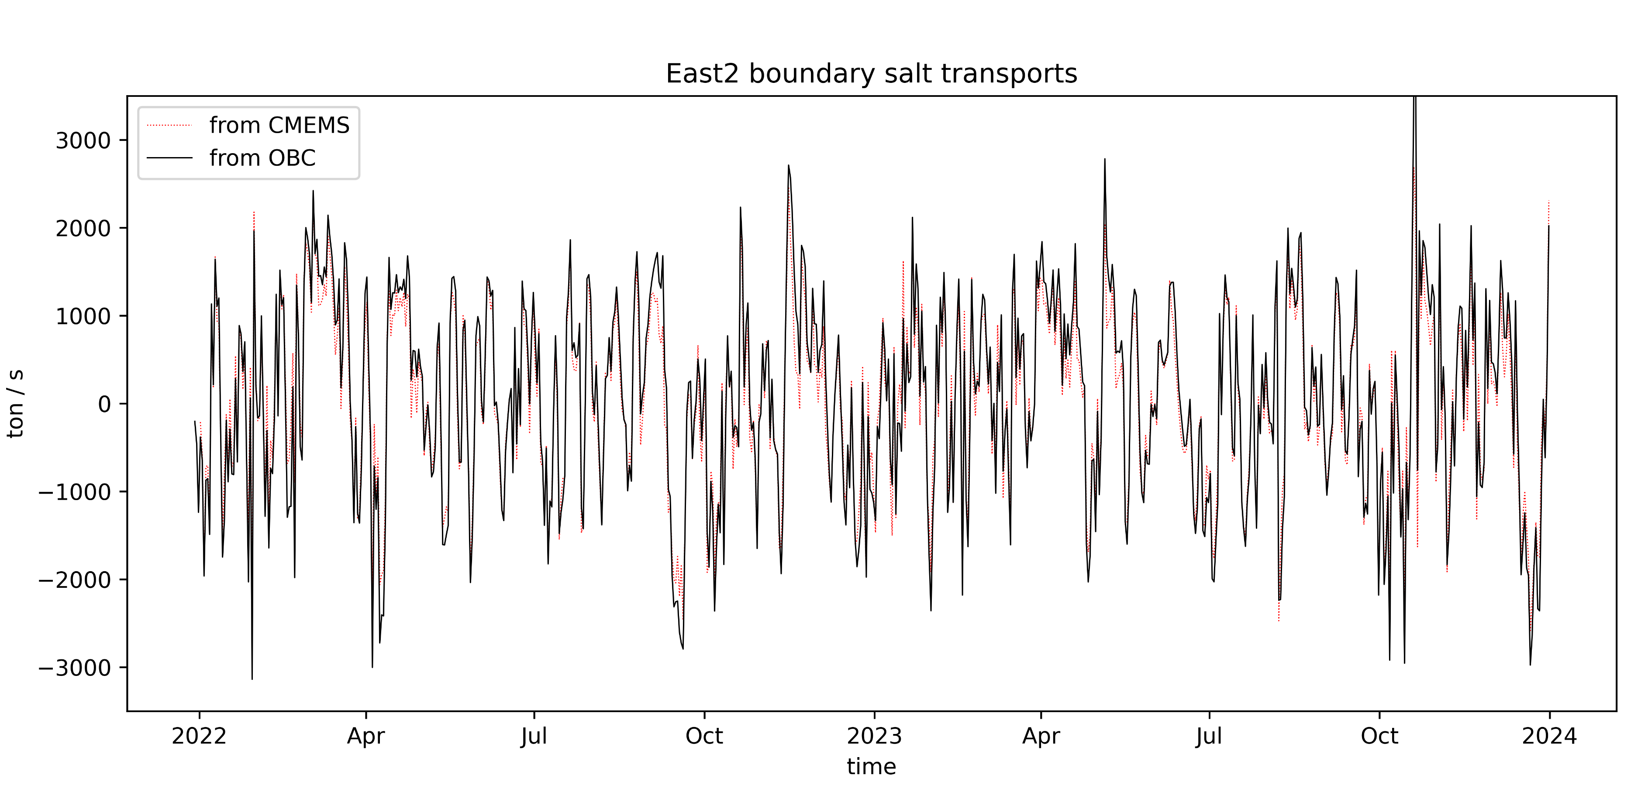

Slide 6
